Slide 1
Typing genius

Slide 2
Project Partners: 1. Reyad Hossain (Roll-17) 2. Fahim Faisal (Roll-41)

Slide 3
Outlines
Objective
Resources
Menus and submenus
Gameplay
Main features
Additional features
Bonus features
A sense of winning
Game structure
Challenges
Lessons learnt

Slide 4
Objective
To understand the practical uses of C language
To make a step towards working with graphics
To develop ideas about game development

Slide 5
Resources
C language
Code Blocks 13.12 version
Borland Graphics Interface(BGI)
Internet
Images

Slide 6
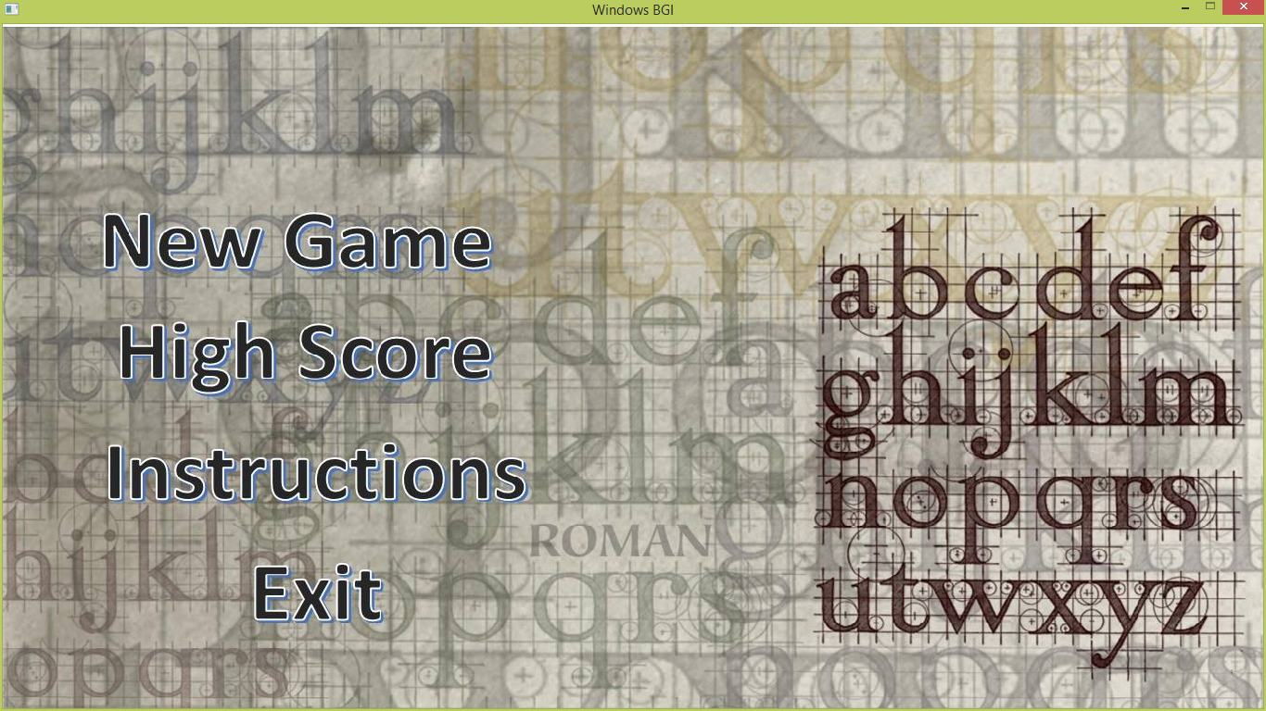

Slide 7
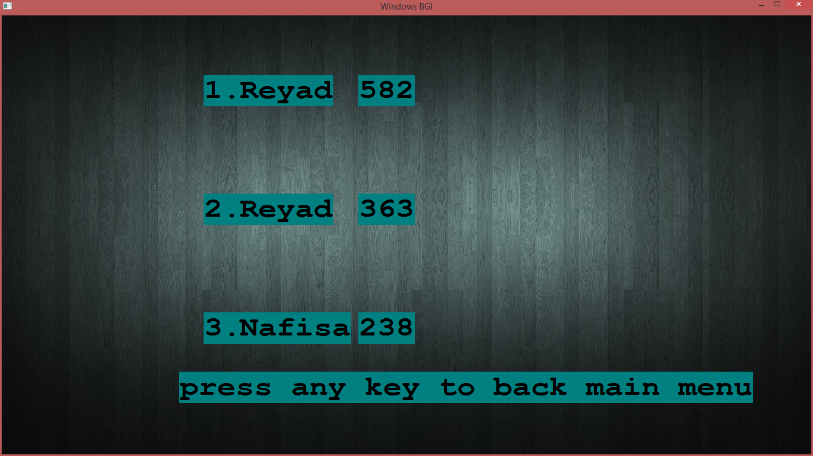

Slide 8
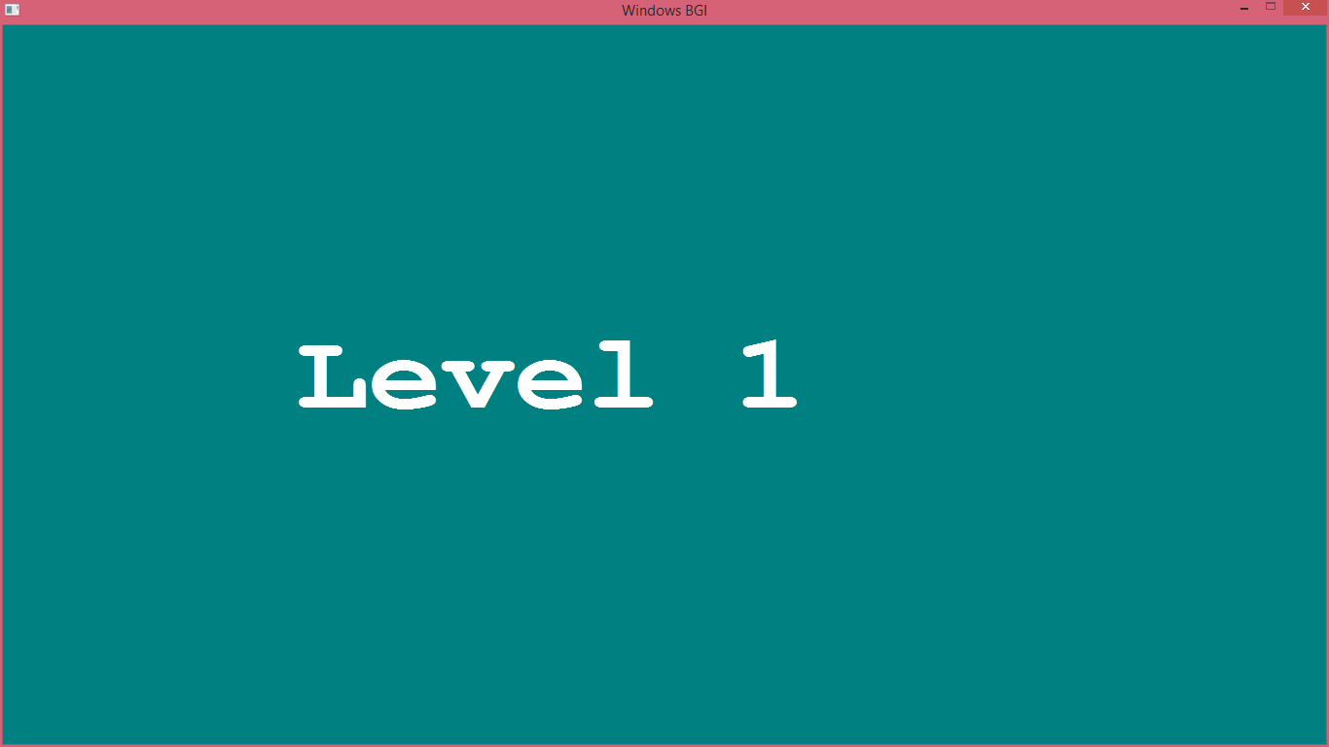

Slide 9
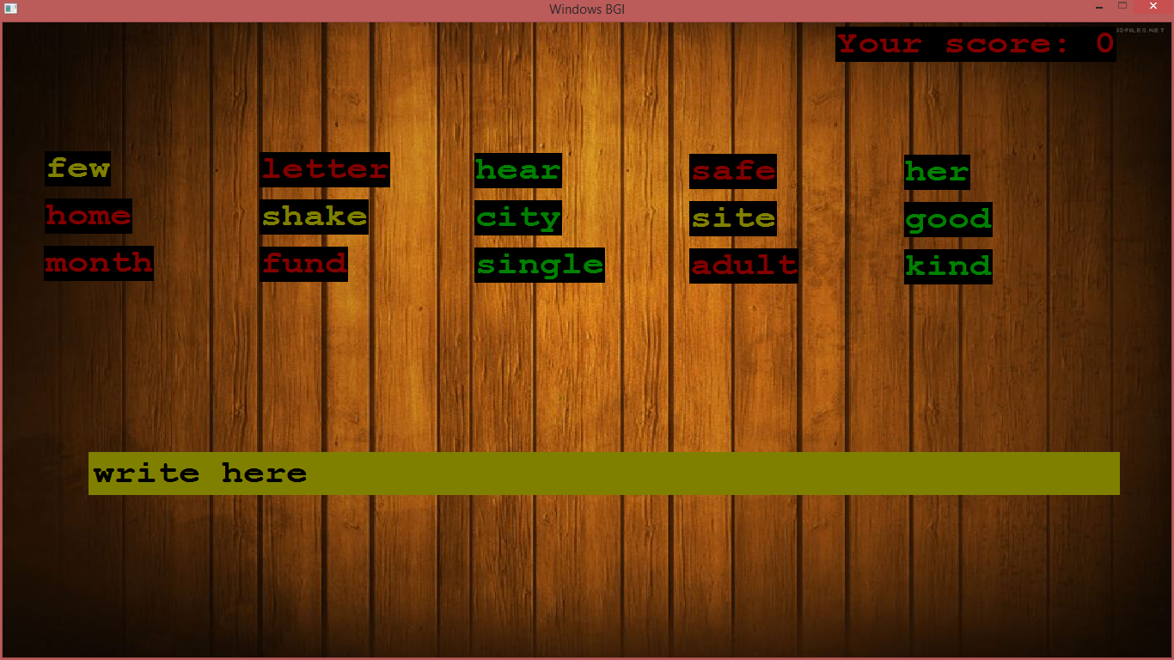

Slide 10
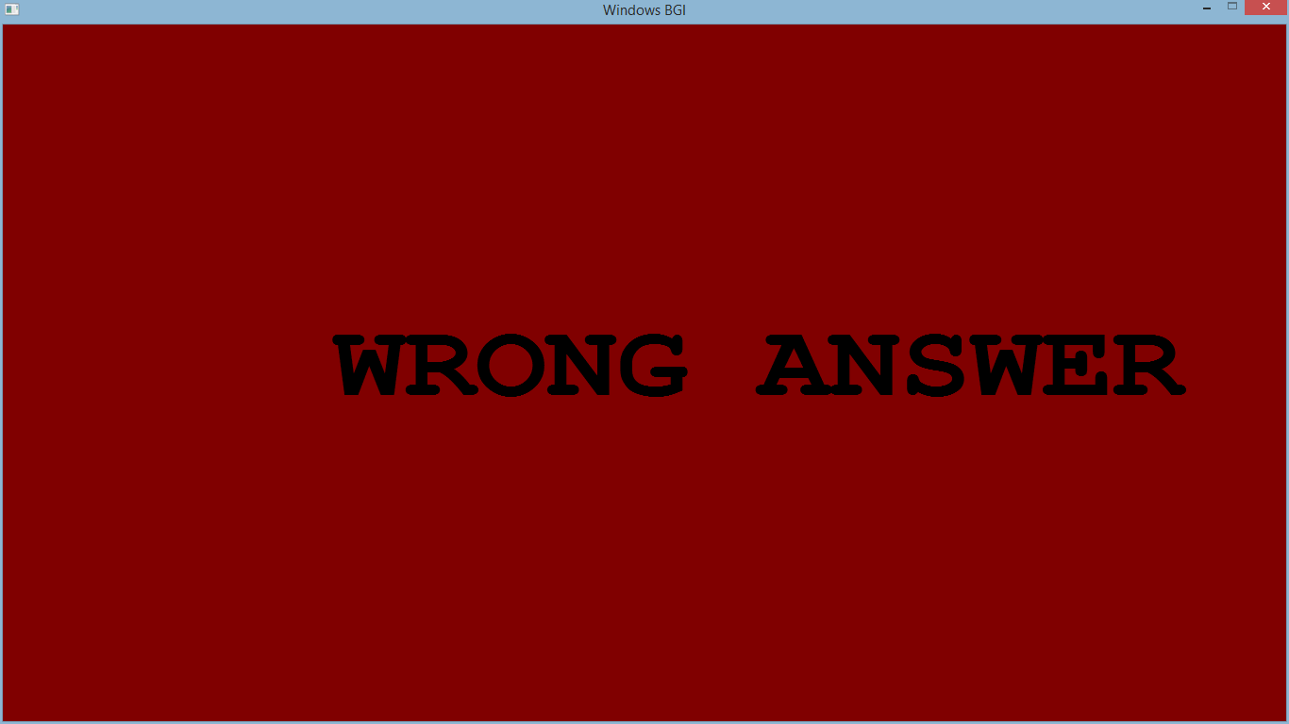

Slide 11
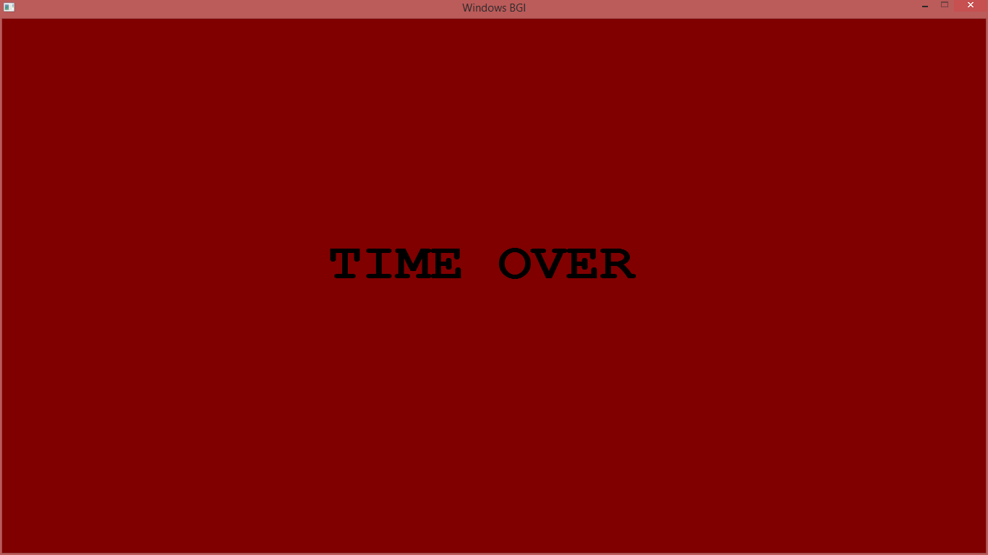

Slide 12
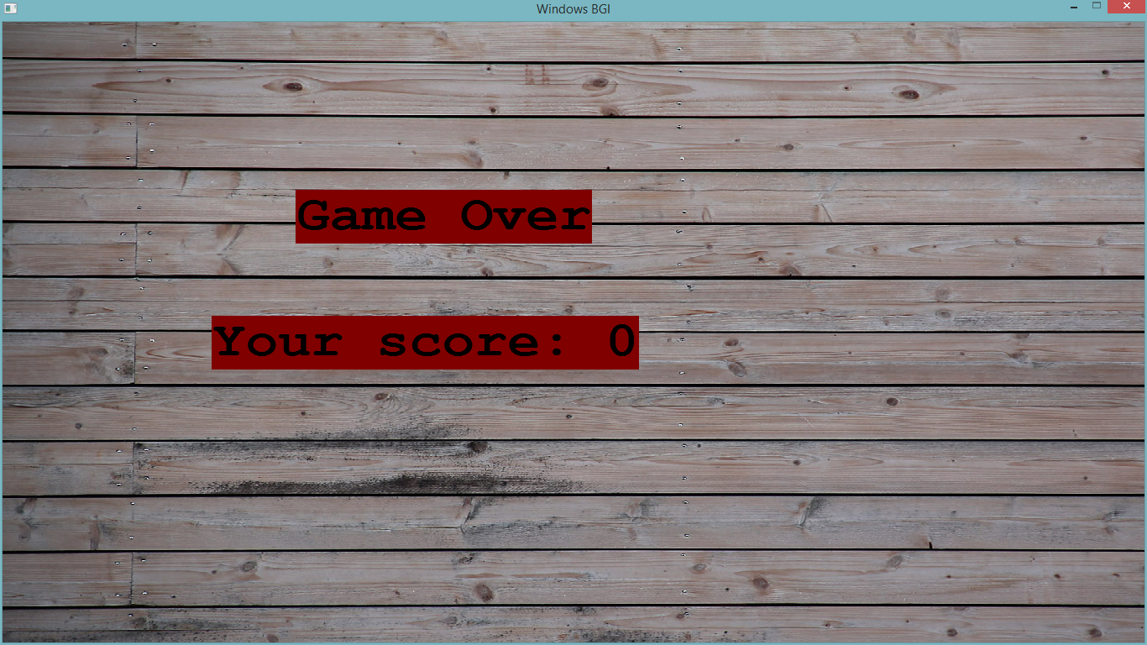

Slide 13
Gameplay
Level 1:
The player has to type the green words
After each word he has to type a space to submit the word
He is not allowed to type any red word
Typing the yellow words will give him bonus points
Each letter of a correctly typed word contains a single point
The amount of time decreases by one second after each round

Slide 14
Gameplay
Level 2
The player has to type all the green letters of each word sequentially
There will be no spaces among the letters
He has to type a space after finishing all the green letters
Typing the yellow letters will give extra points
He is not allowed to type the red letters
Doing so will cause the game to be over
Each letter contains a single point

Slide 15
Main features
Interactive menus
A professional look in the interface
Different levels of game play

Slide 16
Additional features
New Game
High Score
Instructions
Exit

Slide 17
Bonus Features
Use of pictures in instruction
Change of appearance

Slide 18
A sense of winning

Slide 19
User Friendliness
Attractive menu option
Instruction list has been added
Easy gameplay
Use of images in instruction
Leader board

Slide 20
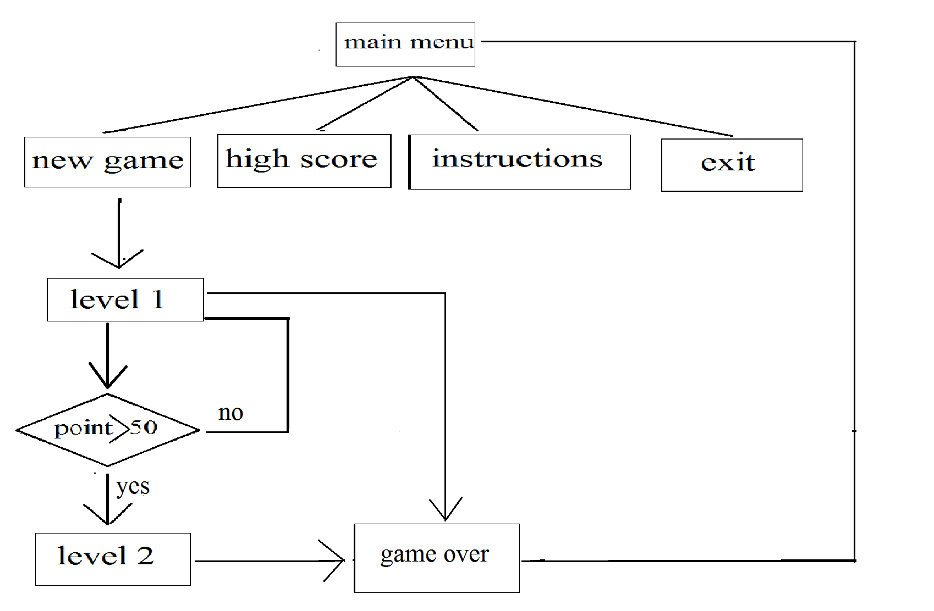
Game structure

Slide 21
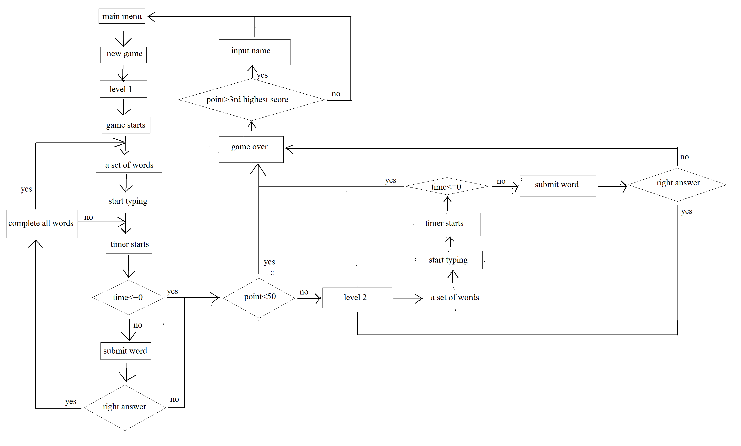

Slide 22
Coding Challenges
A huge number of words
Generating random words every time
Timer
Use of several pictures in instruction for a better understanding of the game
Flickering
Creating interactive system
The code may crush any time without any bugs

Slide 23
Lessons learnt
Real life implementation
Idea about game development
First time experience in user friendly application
Teamwork

Slide 24
Thank you

